Slide 1


AI Agent for Financial Literacy
This project focuses on building an intelligent AI Agent capable of educating users about essential financial concepts such as UPI, EMI, loans, credit scores, and preventing online scams. It provides guidance in an interactive and bilingual manner.
Presented by:
Technology & Platform:
Archita Sinha
IBM Cloud & Watsonx.ai
IBM SkillBuild Virtual Internship
Edunet Foundation
GitHub: github.com/architaa1/AI-Agent-for-Financial-Literacy

Slide 2


Imagine
you're at your local tea shop, and the owner gets a “You’ve won cashback! Click here” UPI message.
One click later… ₹5,000 is gone. Instant shock, instant lesson..

Slide 3





The Financial Literacy Gap in India
Digital India
Confused Citizen
Rapid adoption of digital transactions and UPI apps.
Many citizens are puzzled by complex financial concepts.
Knowledge Deficit
Security Risks
Language Barrier

Slide 4


Objective: Bridging the Knowledge Gap
Bilingual Guidance
Step-by-step support in English and Hindi.
Empower Decisions
Enabling smarter, more confident financial choices.
Close the Gap
Connecting technology with understanding.

Slide 5




Accessibility for All: The Beneficiaries
Students
Senior Citizens
Small Business Owners
Rural Users
Learning financial basics early.
Navigating the digital economy safely.
Accessing information in local languages.
Managing business finances efficiently.

Slide 6
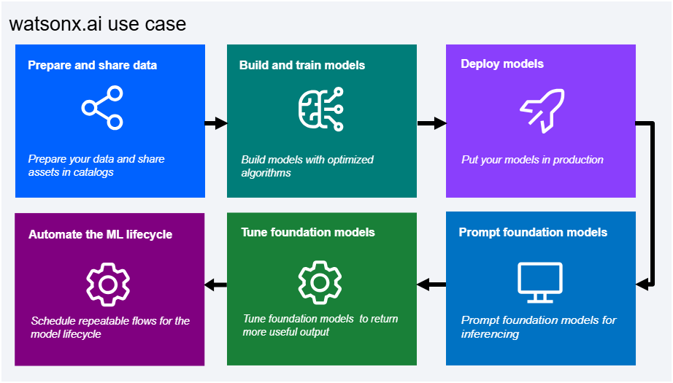


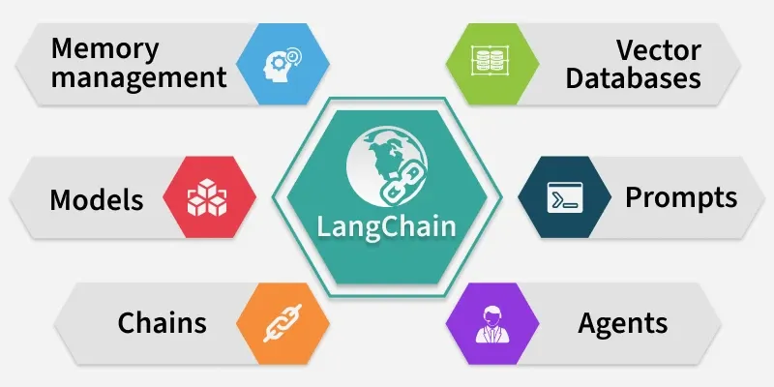

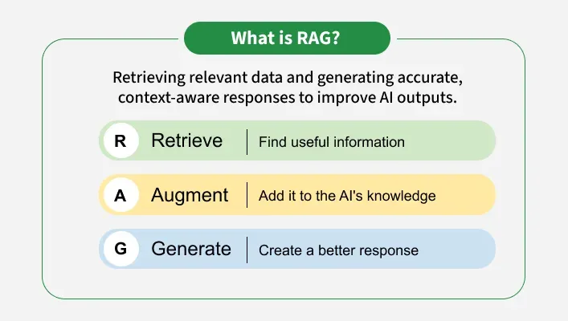
Key Tools and Technologies
Watsonx.ai
Foundation Model for core intelligence.
LangChain
Orchestration of RAG pipeline.
RAG
Grounded, verifiable answers.

Slide 7
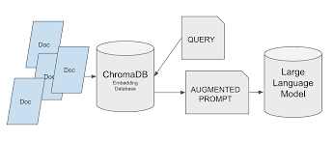

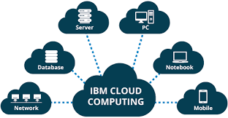

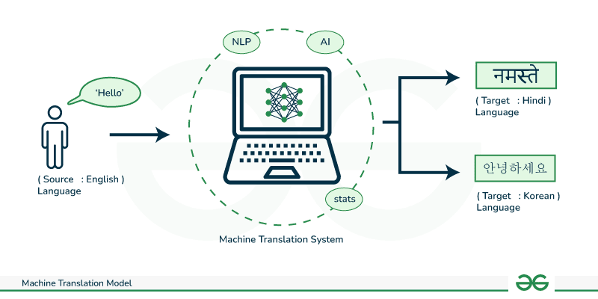
Key Tools and Technologies
ChromaDB
Vector database for knowledge storage.
IBM Cloud
Secure and scalable infrastructure.
Translator
Bilingual support (English + Hindi).

Slide 8







Why These Technologies?
“It’s not just a chatbot. It’s a trustworthy teacher.”
Compliance
Accuracy
Scalability
Security
Reinforcing trust through a layered, protective tech stack.

Slide 9
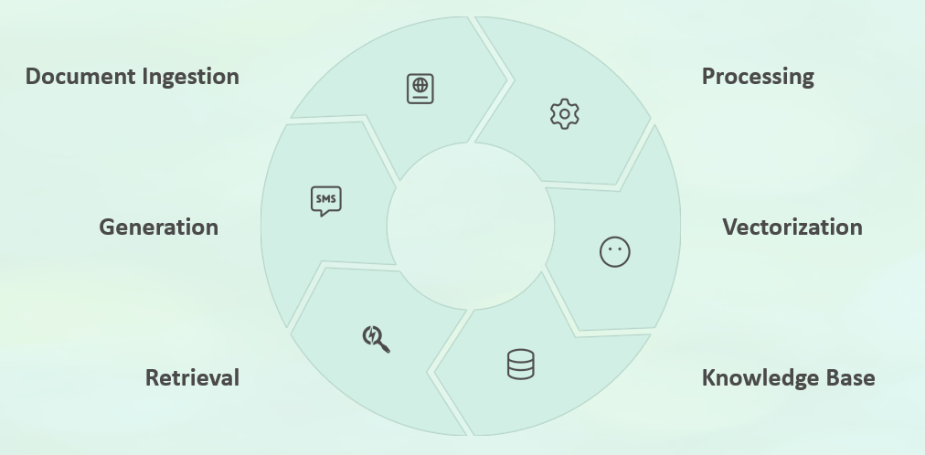
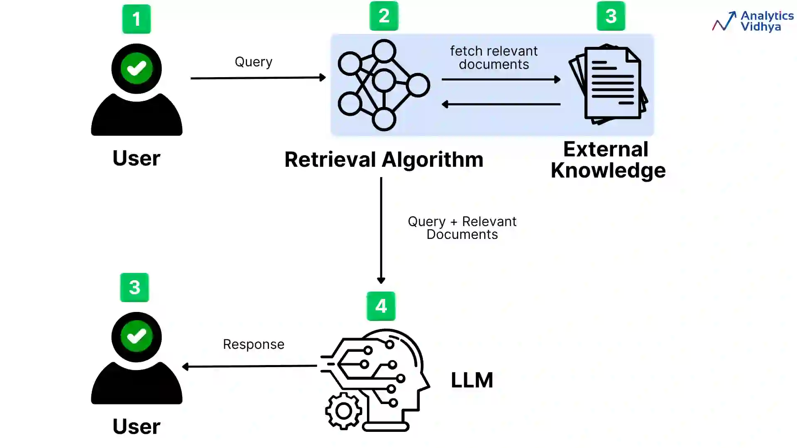
System Architecture: RAG Workflow
A circular flow simplifying the Retrieval-Augmented Generation (RAG) process.

Slide 10




RAG in Action: Grounded Answers
The system reads verified documents before generating a response.
User Query
“What is UPI?”
Retrieval
Searching verified financial documents.
Bilingual Answer
Response in Hindi + English.
Grounded in real data. Not guesses.

Slide 11



Demo Overview: Real-World Testing
The system's capabilities were validated by testing it against typical user financial queries, showcasing its multilingual and computational strengths.
UPI Setup Guidance
EMI Calculation
Credit Score Advisory
Provided clear, step-by-step UPI setup instructions in Hindi.
Calculated monthly EMI values accurately based on user inputs.
Explained credit score factors and offered improvement tips using contextual recall.
The demo confirmed the system's ability to handle multilingual needs, complex calculations, and contextual conversations—proving its utility as a genuine financial learning tool.

Slide 12
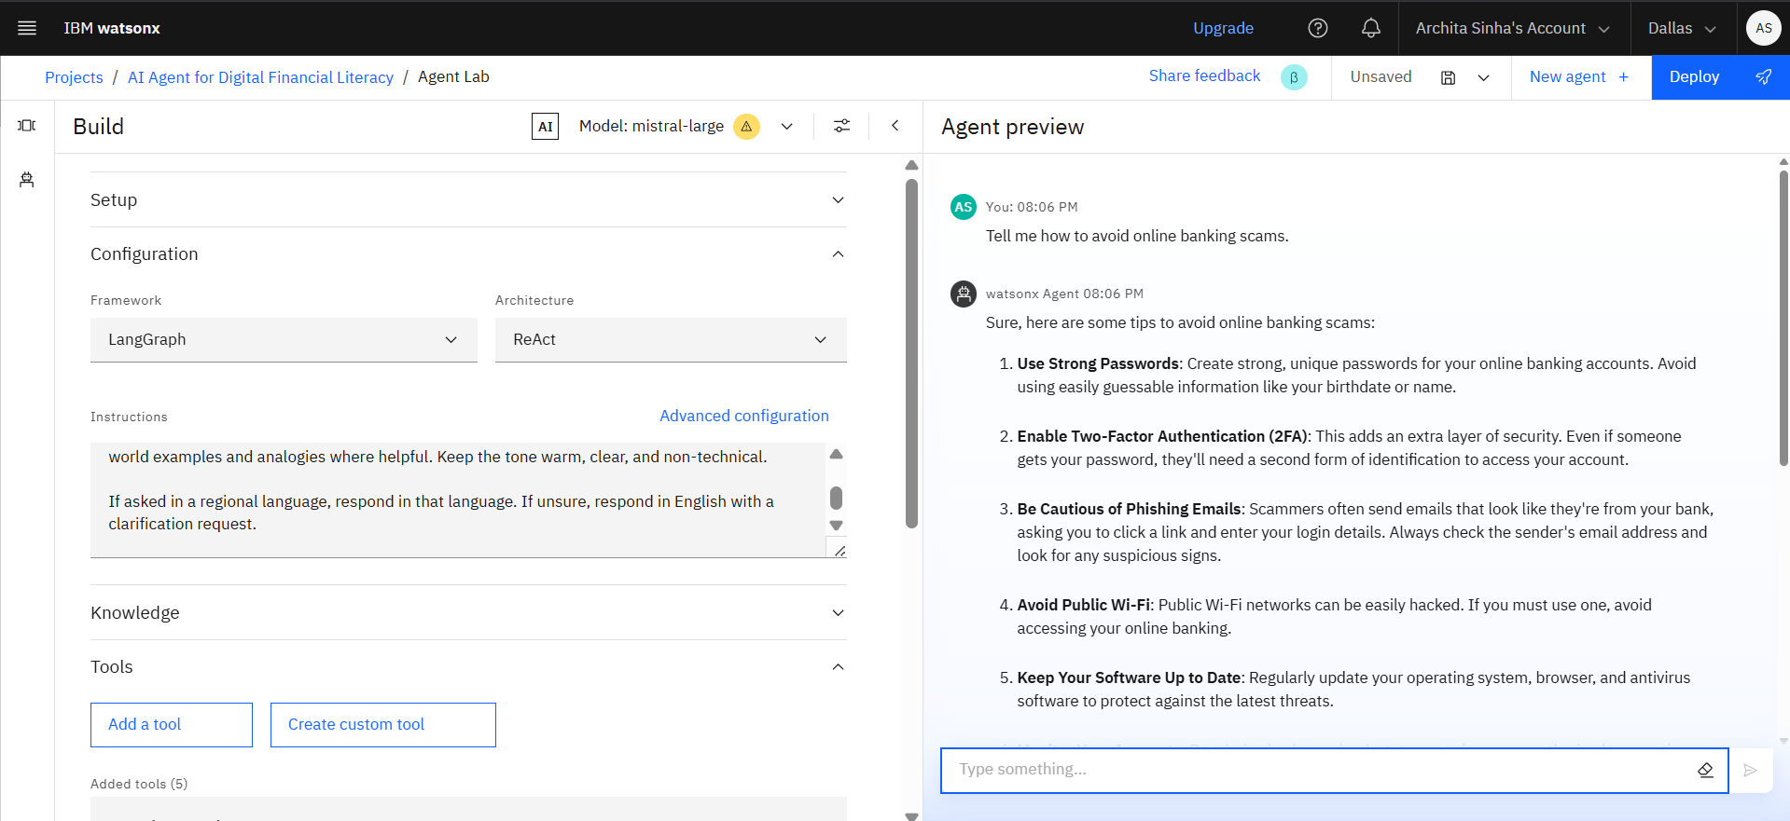


Slide 13
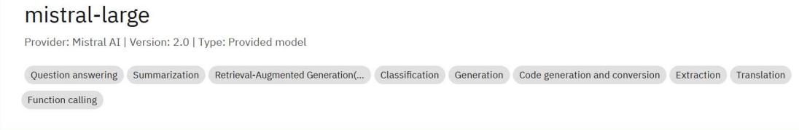

Slide 14
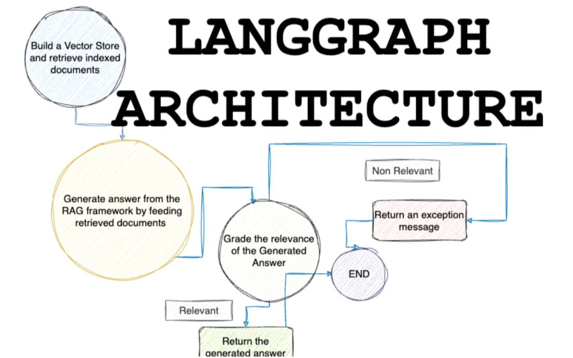
4

Slide 15
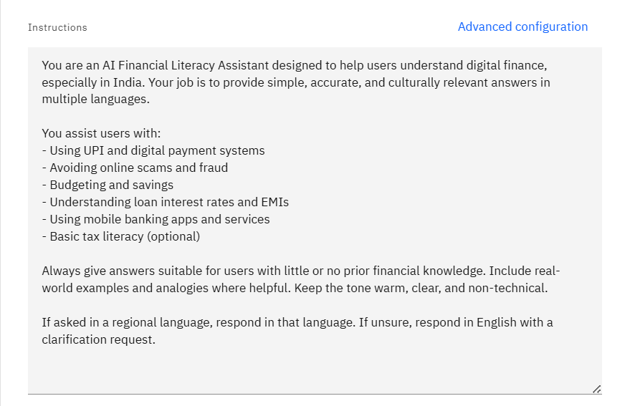

Slide 16
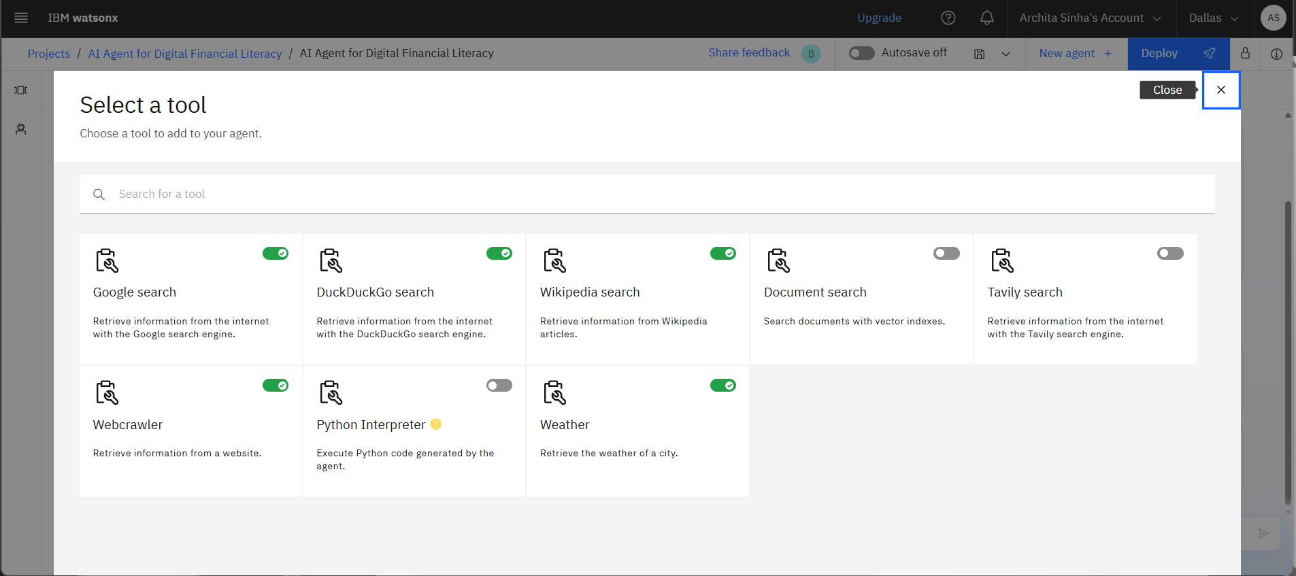
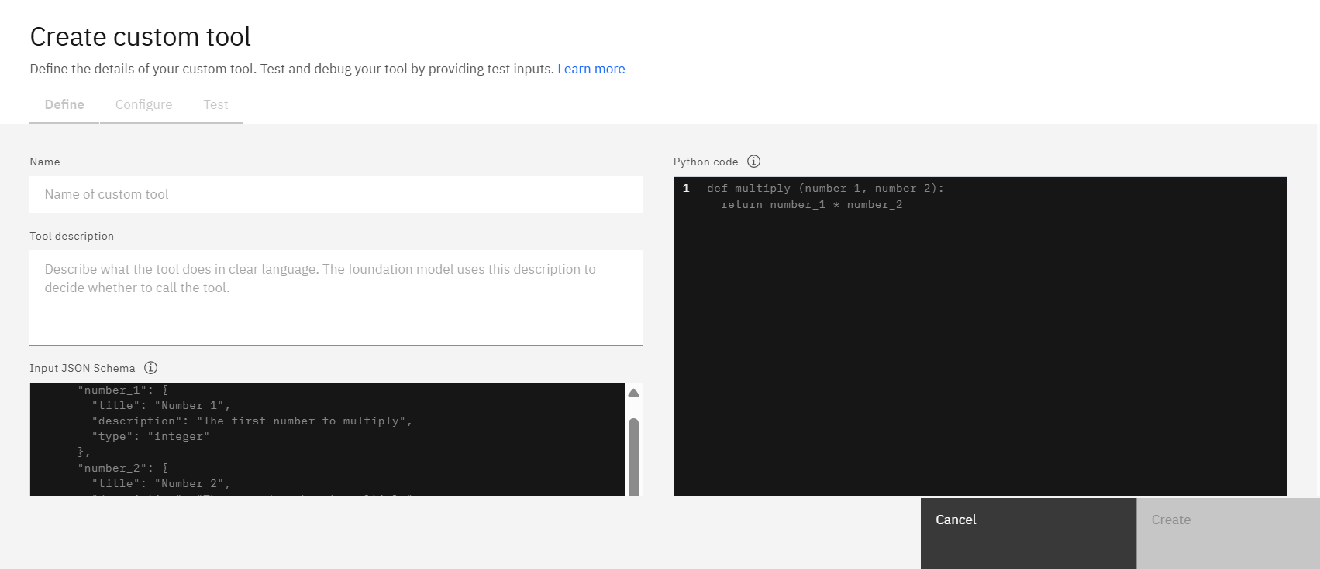

Slide 17
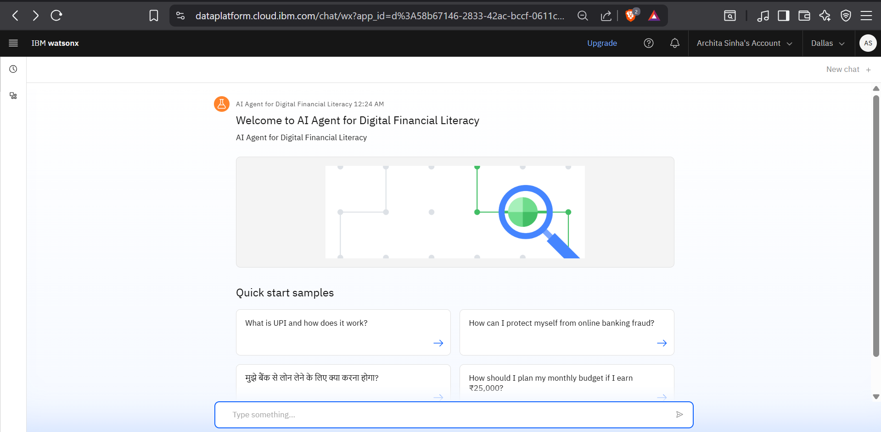

Slide 18
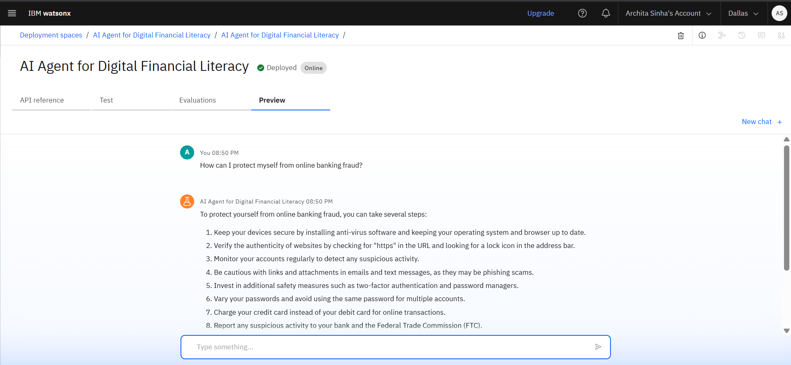
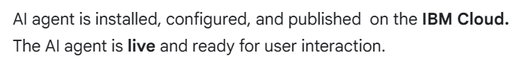

Slide 19
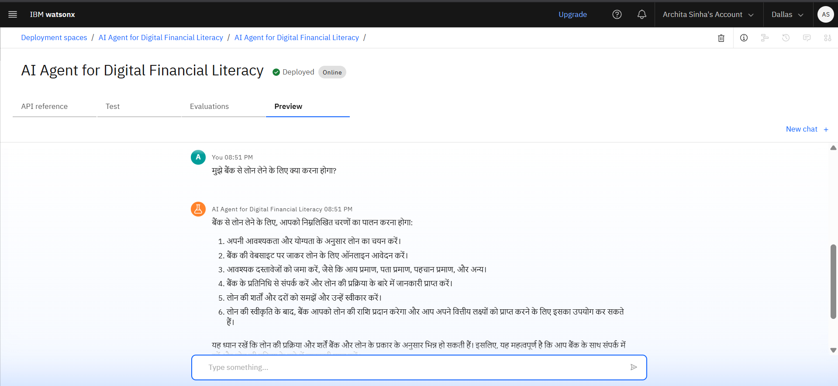

Slide 20
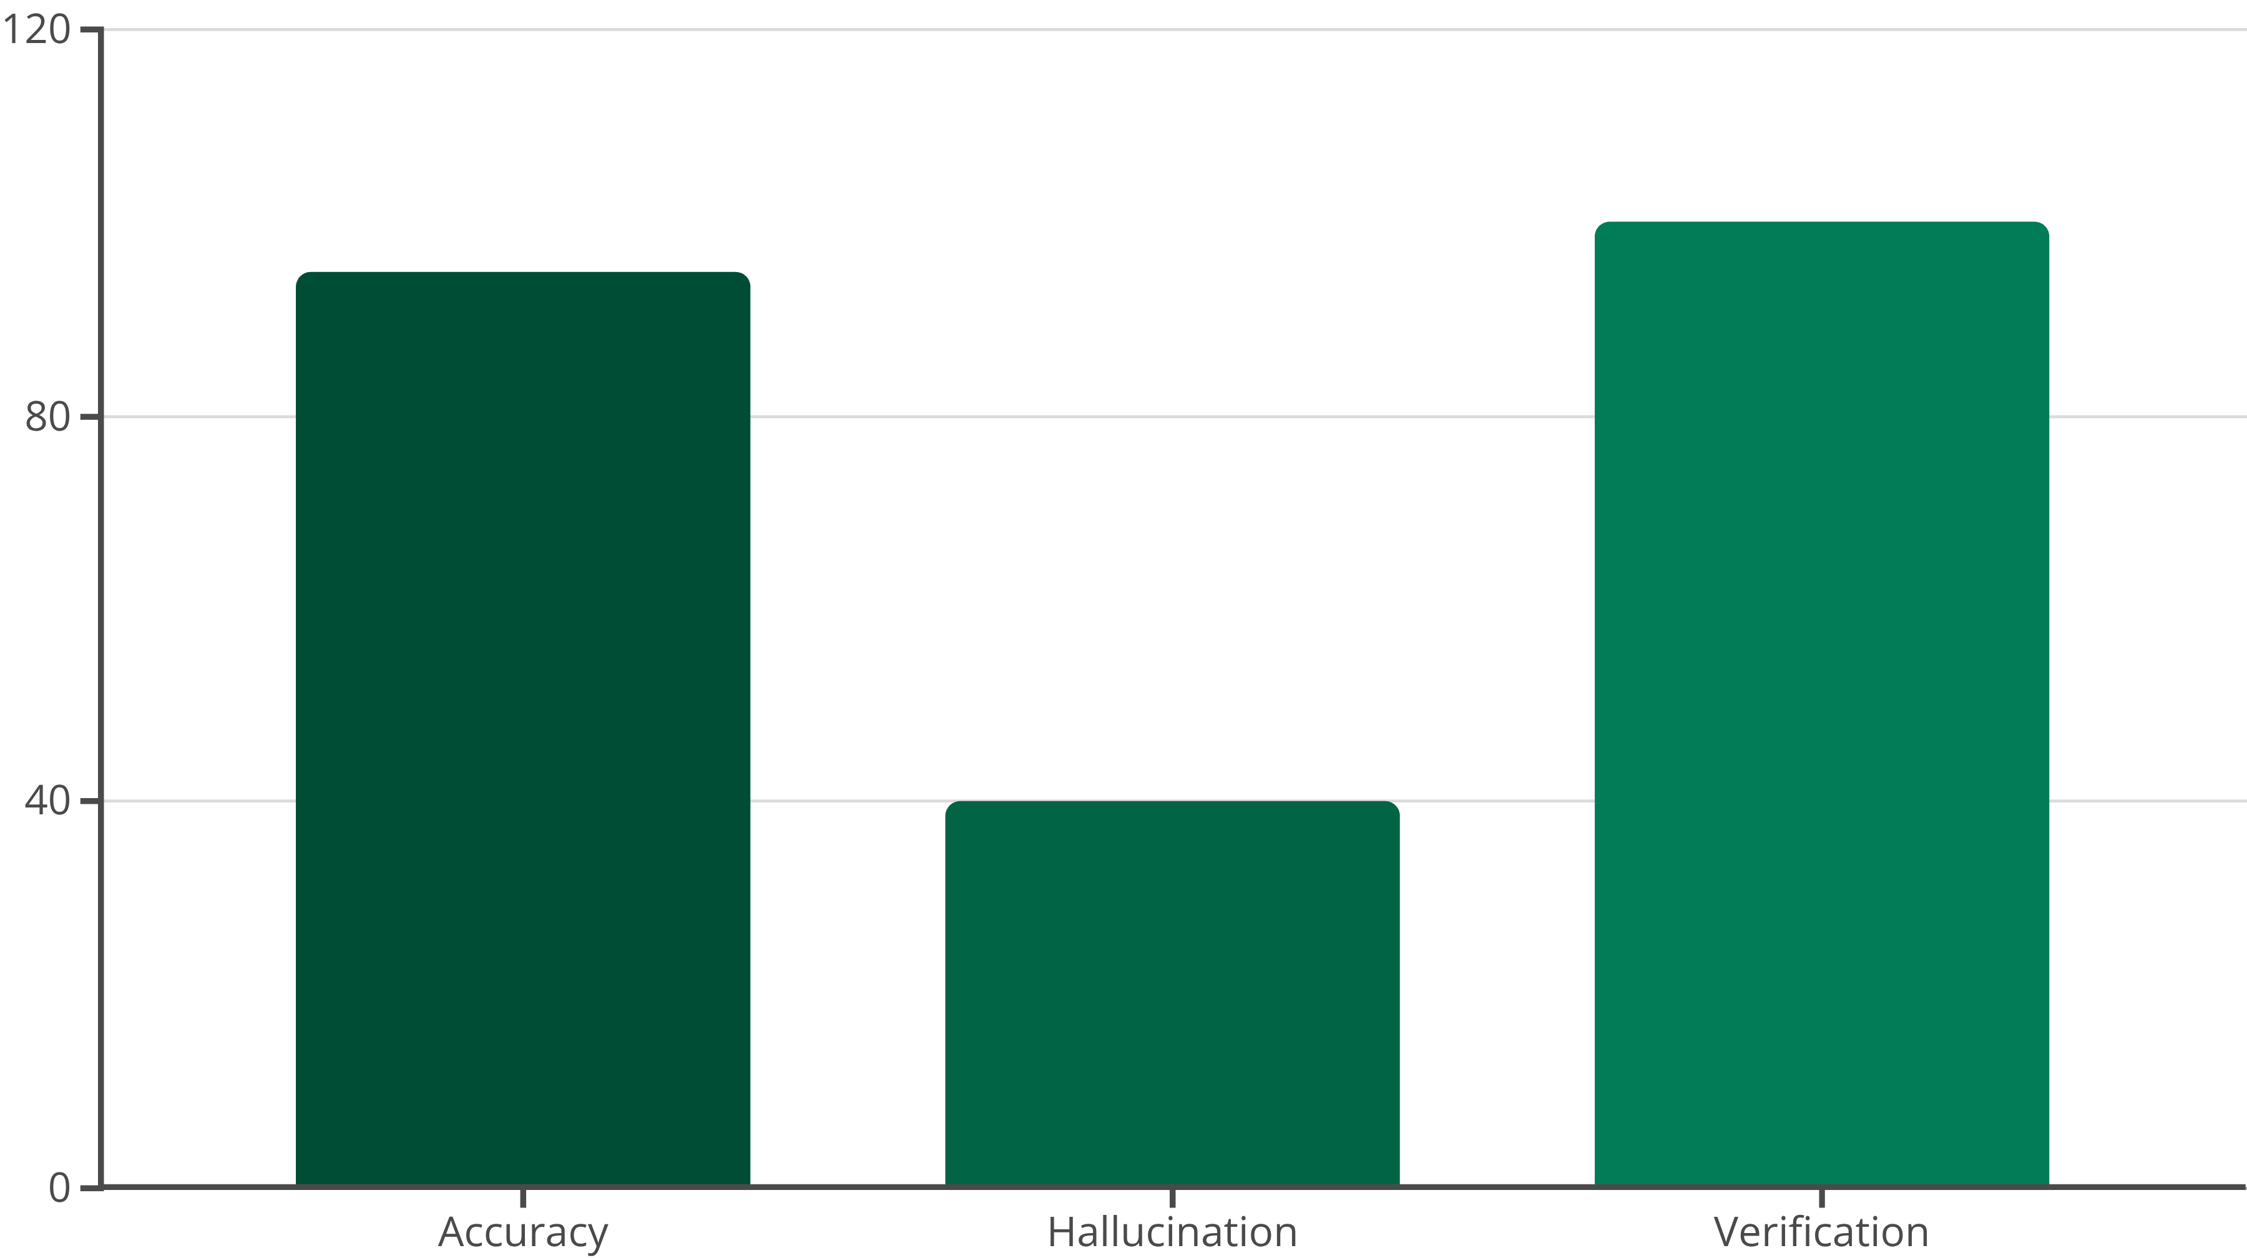
Impact and Measurable Results
95%
60%
100%
Accuracy
Hallucination Reduction
Verified Calculations
High precision in financial information delivery.
Significant decrease in fabricated responses.
Accurate EMI and financial calculations.

Slide 21
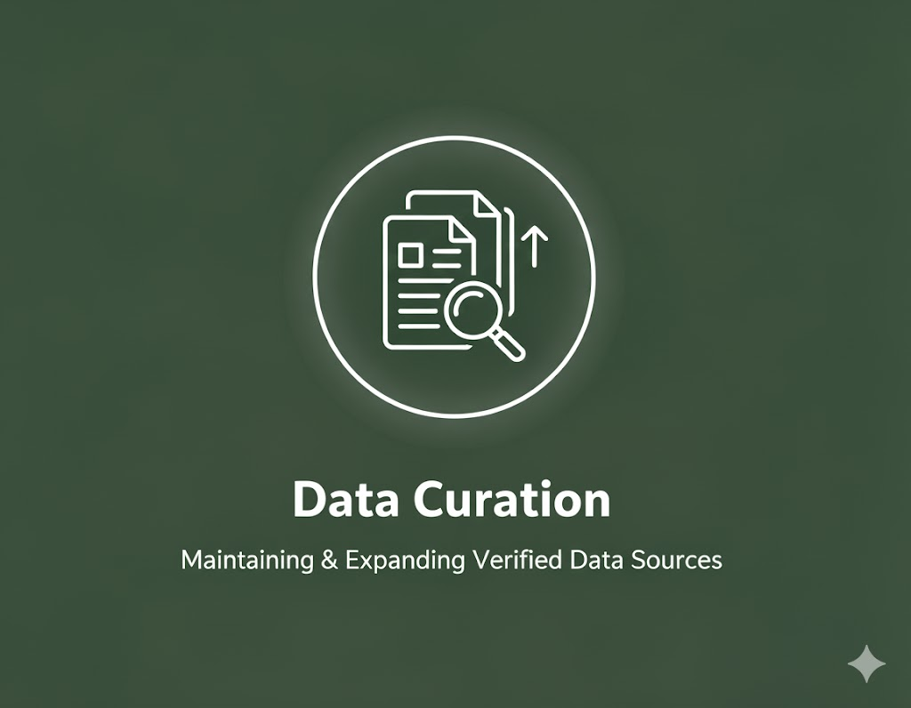
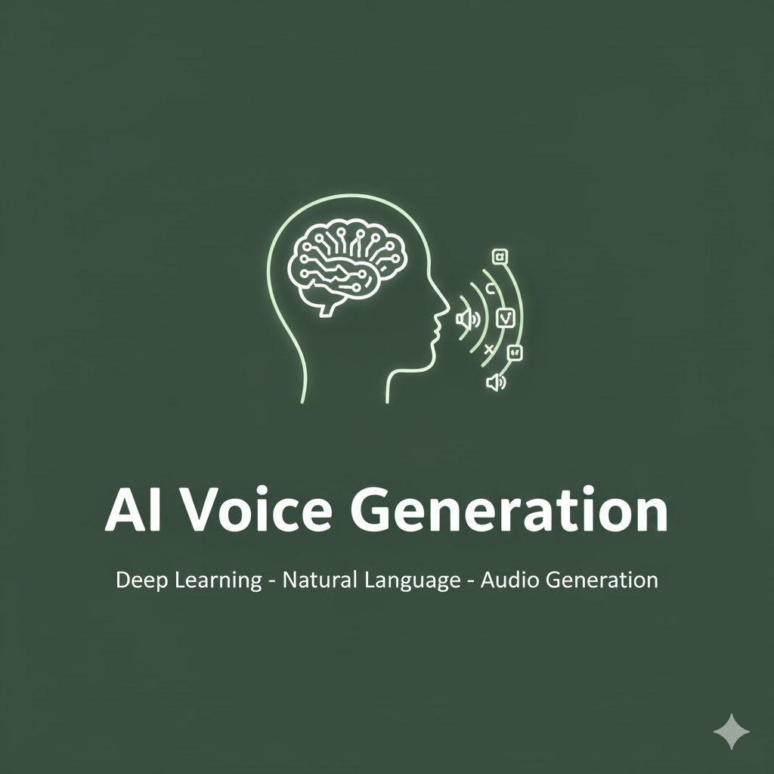
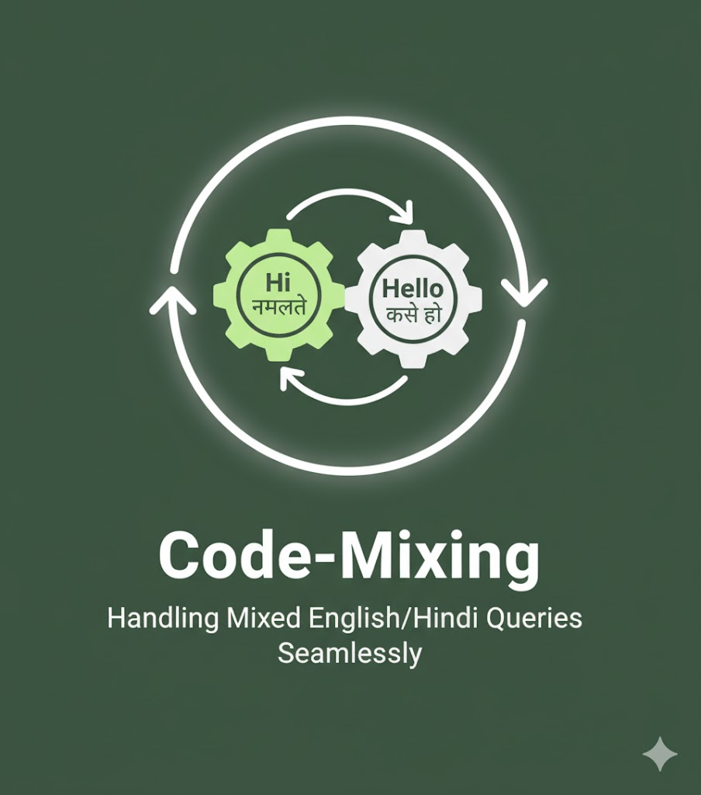



Challenges & Future Scope
Future Milestones

